Slide 1
Used Car price prediction
Hetansh Patel

Slide 2
ABOUT Data
The dataset contains 3,000,040 rows.
Target field: Price
Number of attributes: 66 - These are the demographics and other features to describe a car
We can explore the possibility in predicting price based on the individual car information.

Slide 3
Data collection
Data Website: https://www.kaggle.com/datasets/ananaymital/us-used-cars-dataset

Slide 4
Problem Statement

Slide 5
Problem Statement
To find the perfect model for the customer so that they can predict there car sale price accurately with minimal information required.

Slide 6
Pre-Processing

Slide 7
Handling NA values
There were NA values in columns
Most of them are Character type. So we can’t just apply random values inside them. Its better to delete the entire rows rather than giving misleading information.

Slide 8
Dropping columns for analysis
Dropped columns which showed similar properties of a car or has no effect on price just by looking at them.

Slide 9
Data Exploration

Slide 10
Reviewing each feature
Body_type (object)
city_fuel_economy (float)
Engine_displacement (float)
Engine_type (object)
fleet (object)
Frame_damaged (object)
Franchise_dealer (bool)
Fuel_tank_volume(object)
Fuel_type (object)
Has_accidents (object)
Highway_fuel_economy (float)
Horsepower (float)
isCab (object)
Listing_color (object)
Make_name (object)
Maximum_seating (object)
mileage (float)
Owner_count (float)
torque (object)
Transmission_display (object)
Wheel_system (object)
year (int)
price (Target Variable) (float)

Slide 11
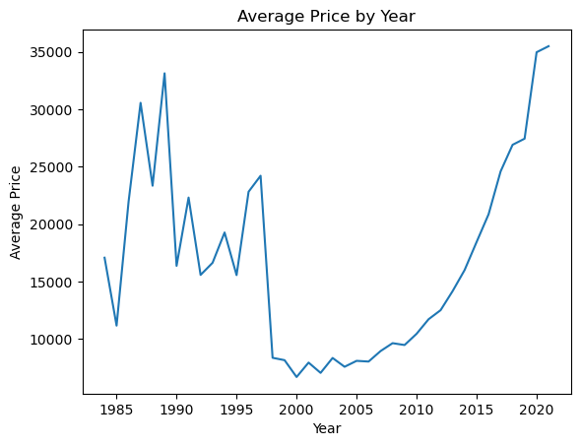
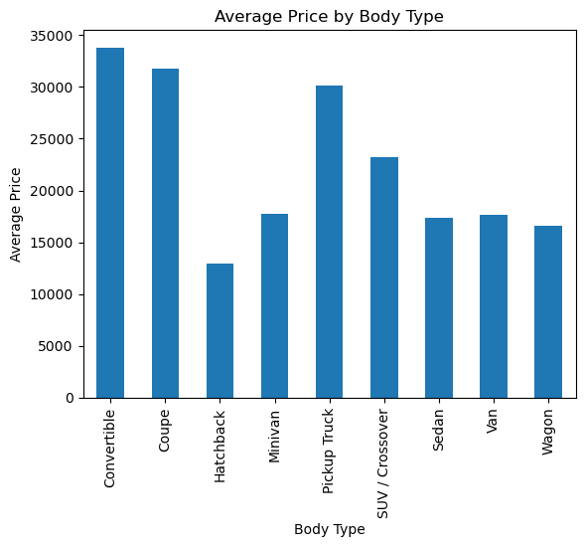
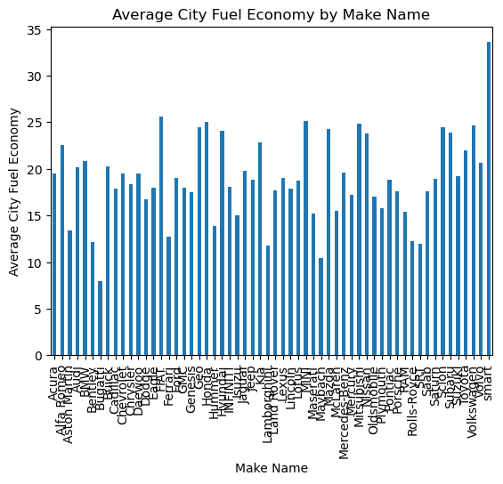
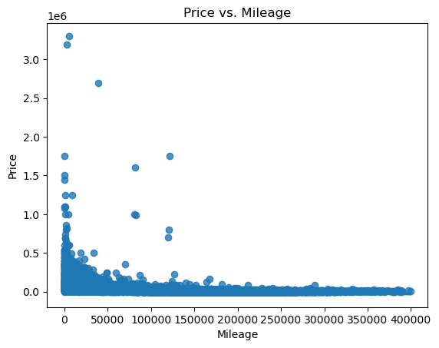
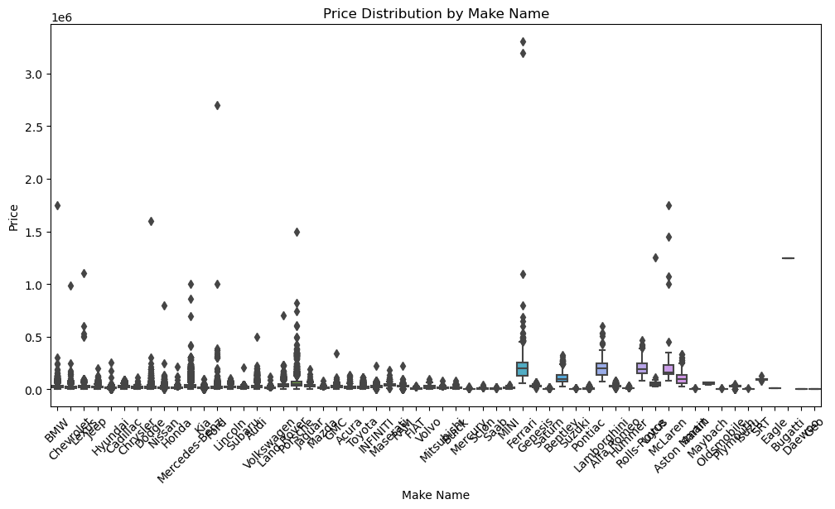
Overview of data

Slide 12
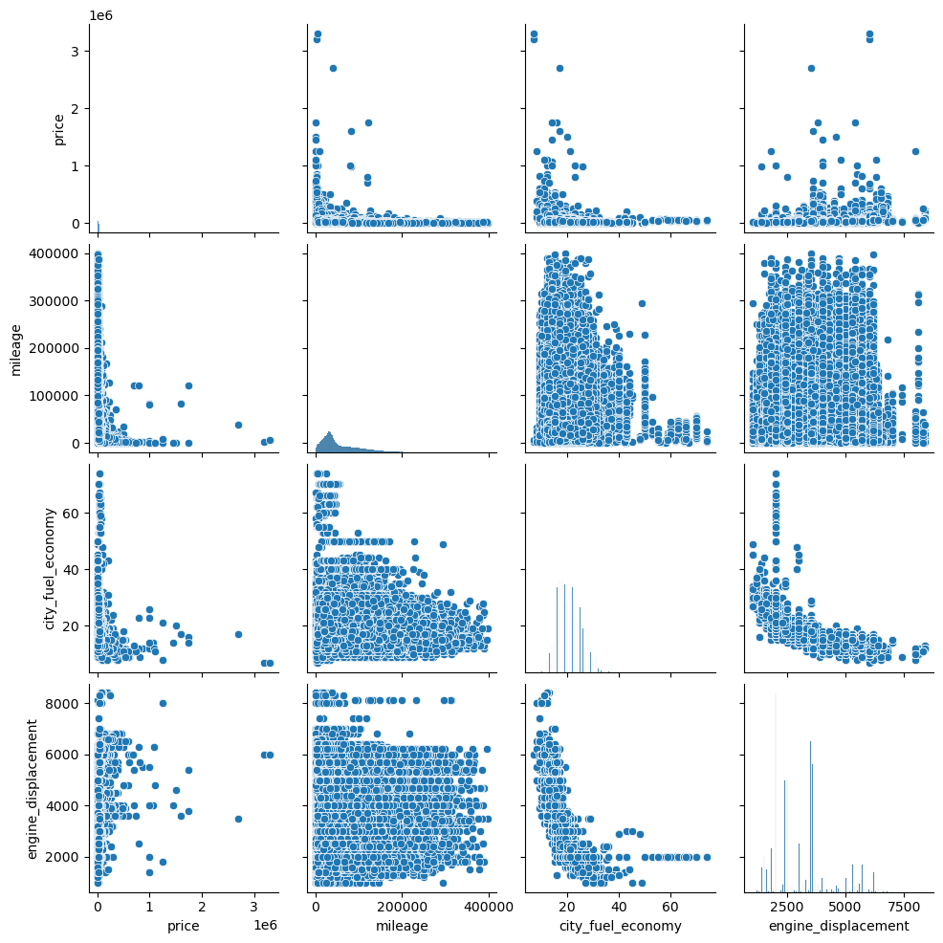
Overview of data

Slide 13
Data Transformation

Slide 14
Data transformation
There were some features that had character type but had numerical information.
There were outliers with extreme values, it was very necessary to remove them because they were diverting data to upper side.
Created categories for Price(target Variable).
Original
After Transformation
380@ 1,800-4,000 rpm
380
Mercedes 2

Slide 15
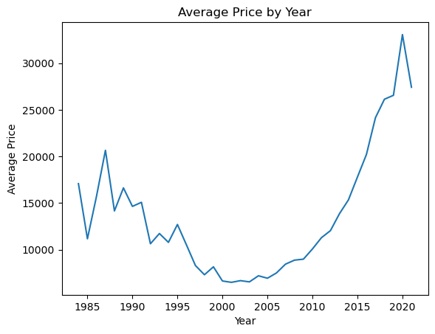
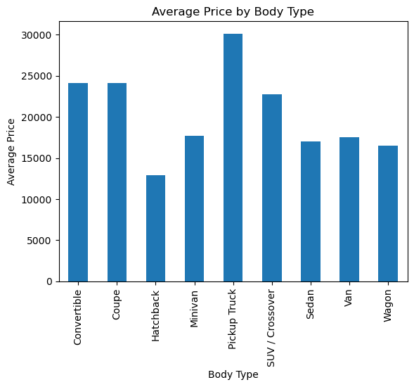
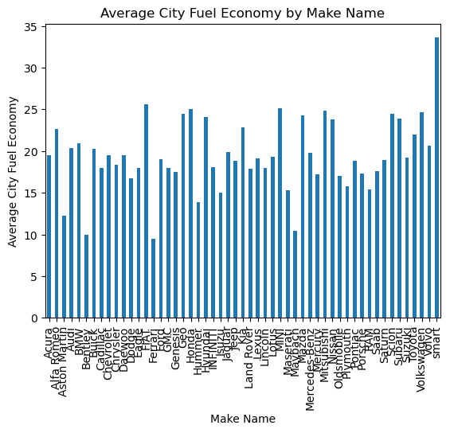
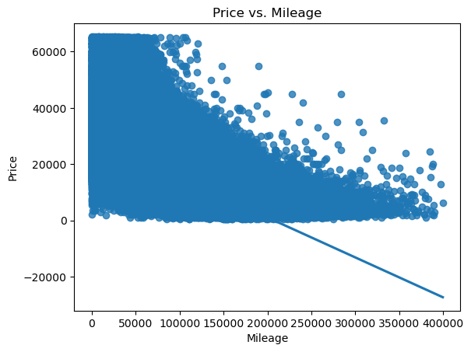
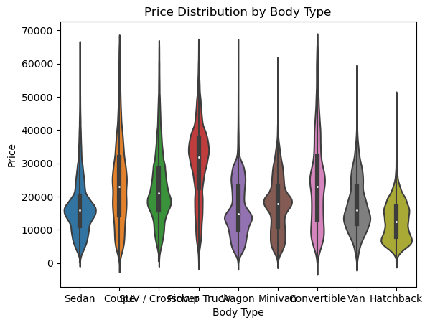
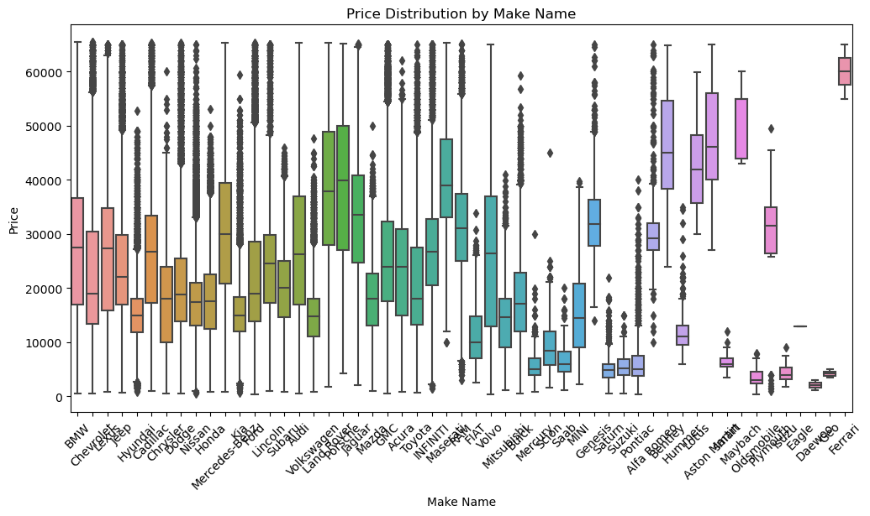
Overview of data after removing outliers

Slide 16
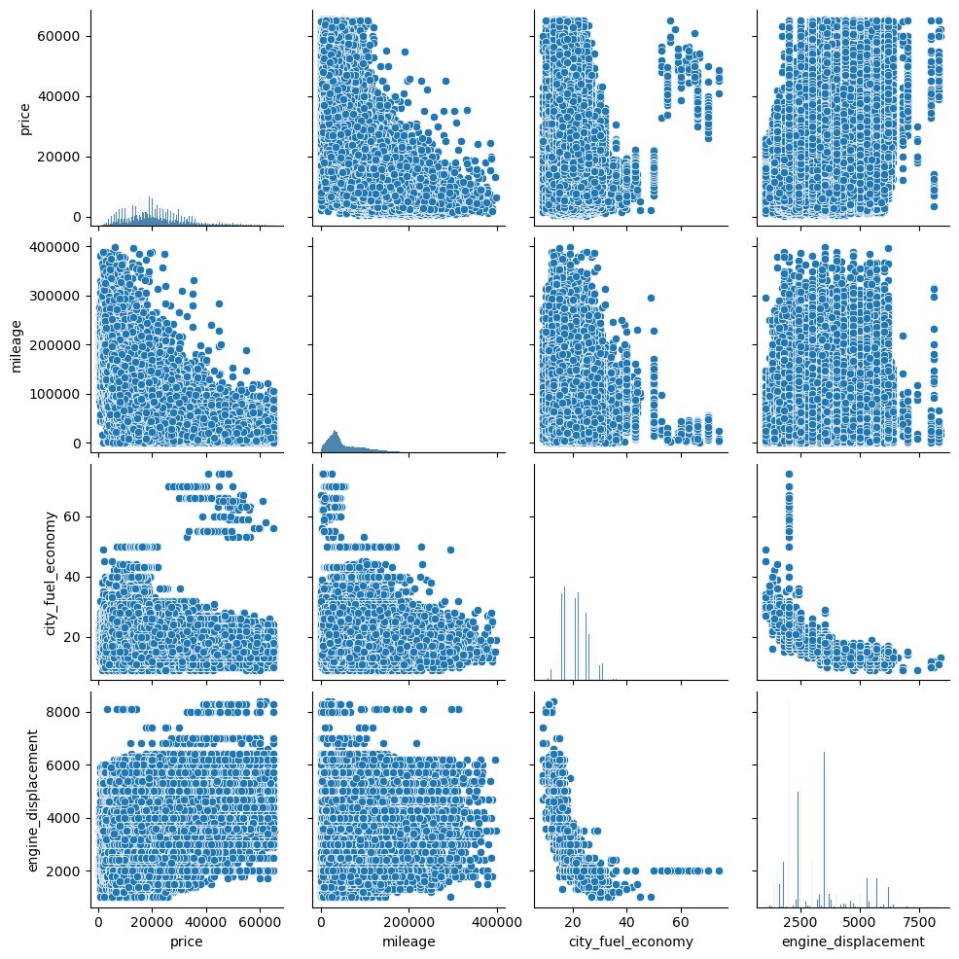

Slide 17
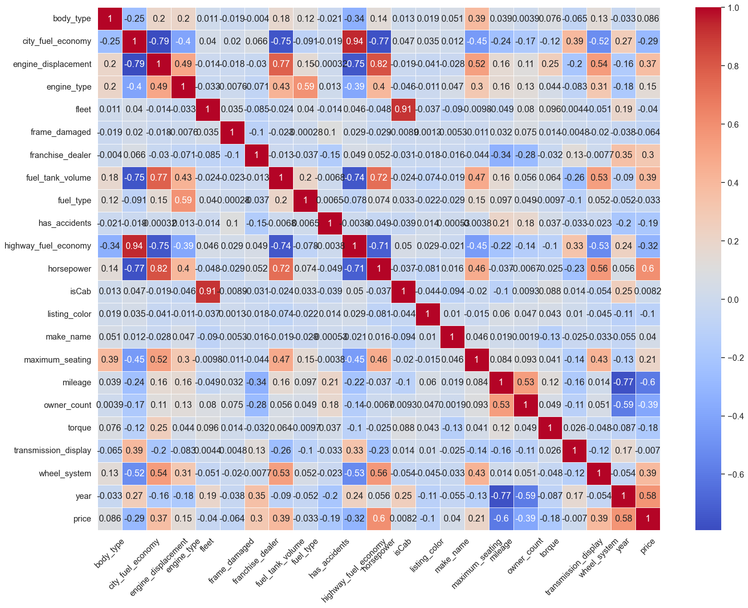
Correlating data
Objective of this was to discern which features within the dataset held the most relevance and which ones were less informative. This process allows us to gain insights into the interrelationships between different variables. It is important to eliminate less influential features to reduce dimensionality and enhancing the efficiency of our analysis. This approach to data reduction ensures to focus more on critical aspects of data.

Slide 18
Methodology

Slide 19
Algorithms
Decision Trees
Random Forest
Support Vector Machines
Logistics Regression
XGB Regressor
ANN

Slide 20
Results

Slide 21
Random Forest
With 11 features
With 4 features
Metric | Value
R Squared | 0.9294
MSE | 0.3350
Metric | Value
R Squared | 0.8688
MSE | 0.6225

Slide 22
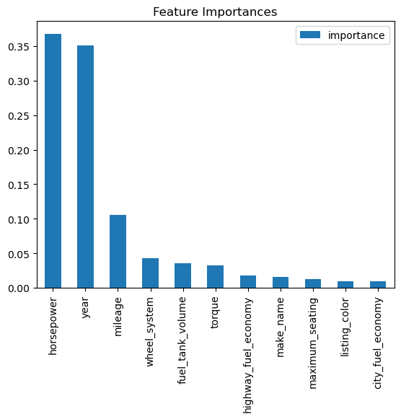
Importance of features

Slide 23
Future Recommendations
There is ample scope for enhancing the models with more extensive data, including newer market trends and consumer feedback.
Collaborating with car manufacturers for data could further refine the predictions.
Continuous model updates and retraining with fresh data are recommended to keep up with the evolving market dynamics.

Slide 24
THANK YOU
Any Questions?

